Slide 1

Docter Booking Android App Walkthrough
Student ID : 24104131
Student Name : Nguyen Ngoc Nguyen
Teach : Tran Dinh Anh Dung

Slide 2
Over View
“Docter Booking Appointment” mobile application
The technology used in App
This app was created by “Kotlin language” on “Android Studio ide”
With “SQLite library” for storing process

Slide 3
Project Outline
ass Diagram
Data Design
UI screenshot

Slide 4

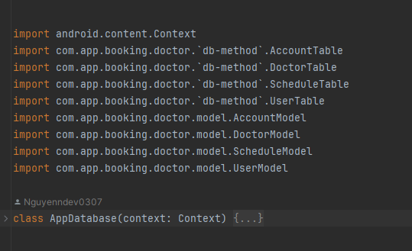
AppDatabase
“db-method” folder contains important dataActivity-related classes such as AccountTable, UserTable, DoctorTable, and ScheduleTable.
Before for all the project, the “AppDataBase.kt” file contains all the activity function related to all our the model class in our project

Slide 5
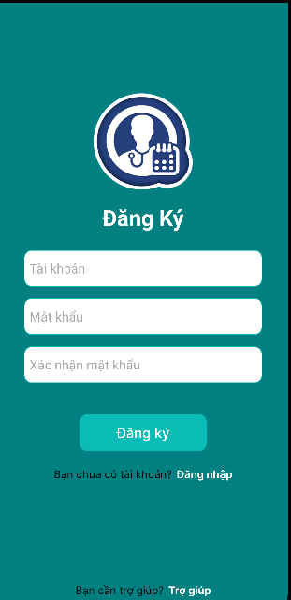
Sign-up Page
For user to Sigin requires:
Email
Password
And confirmed Password
After Sign-in success, User will be navigated to “Edit_Infor_User” page

Slide 6

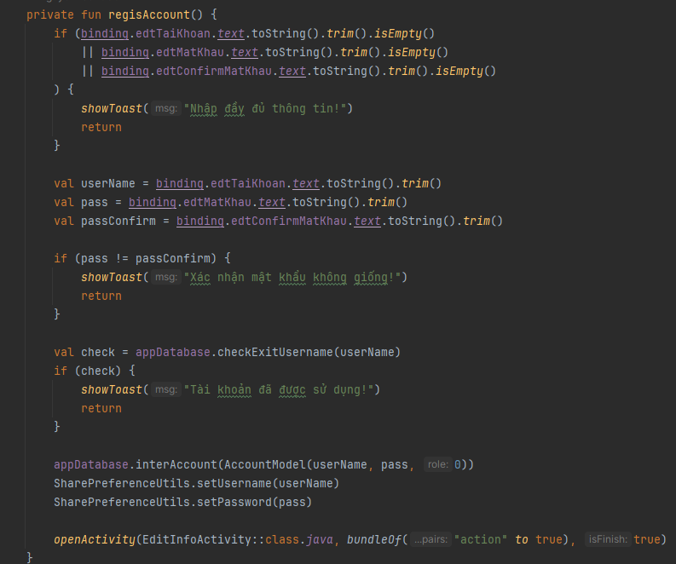
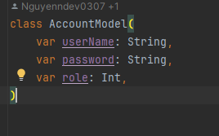
Sign-up Part 1
The location of “LoginActivity.kt” handle all the SingUp/SingIn interaction in our app
Function check whether user has missed in inserting data. If there is, there will show an alert
Get the input data of user , also check the incorrect “password confirm”. If not show the alert.
Also an function to check whether that “username has been exsited” in SQLlite data storage which “appDatabase.checkExitUserName(username) function.
If not, create an account for user, and navigate to “Edit_Infor_user” page
The “AcoountModel” attribute data input

Slide 7
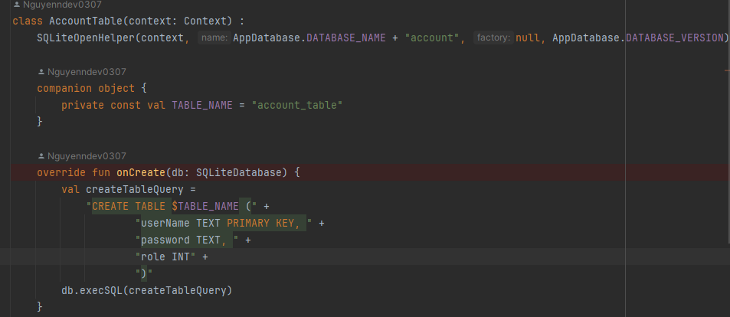
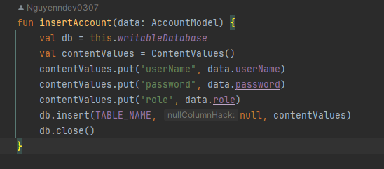
Sign-up Part 2
A Setup for Account table in SQLlite,
The AccountModel code setup:
class AccountModel(
var userName: String,
var password: String,
var role: Int,
)
The function for creating a new user into our SQl lite store

Slide 8
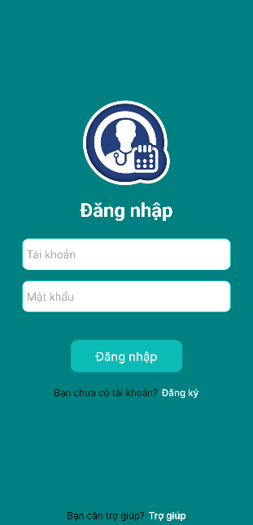
Sign-up Page
For user to Sign-Up requires:
Email
Password
After Sign-in success, User will be navigated to “Edit_Infor_User” page if they did not filled there data into app or if they had filled the data, there would be navigated to “Main_Home” page
If this is the first time of user, they can Sign-Up

Slide 9
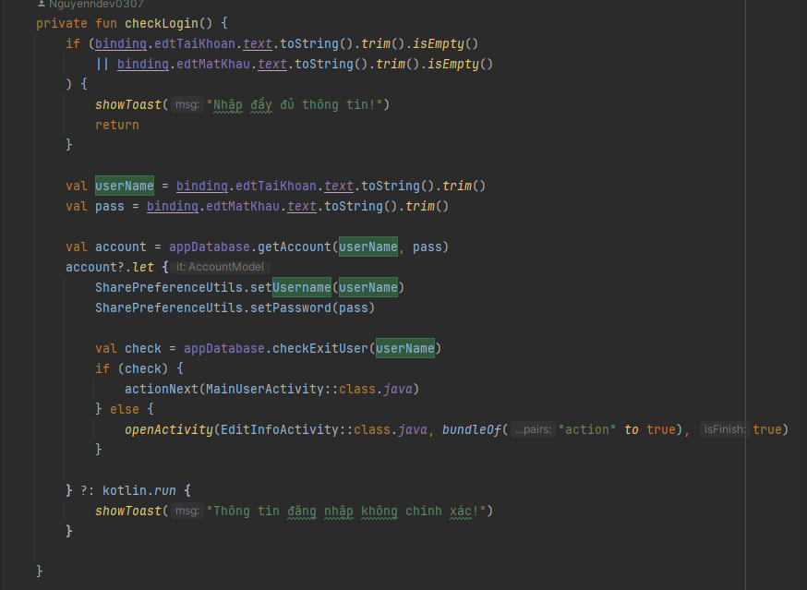
Sign-in Part 1
Function check whether user has missed in inserting data. If there is, there will show an alert
Get the input data of user. The “getAccount function” return the object of Account model or null if that user name not exits.
After that an function to check whether that “username has been existed” in SQLlite data storage which “appDatabase.checkExitUserName(username) function.
If user has filled their information, they will be navigated to “Main_Home_Page” or If they did not, they will be navigate to “Edit_homePage

Slide 10
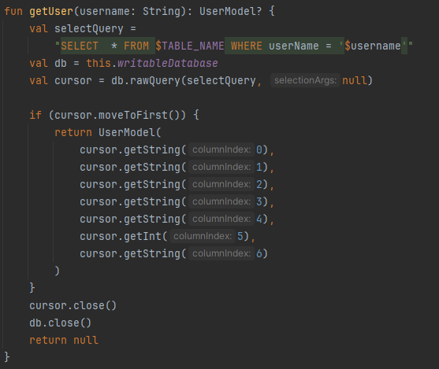
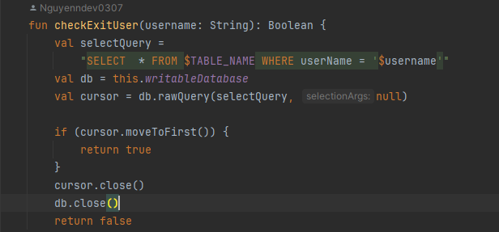
Sign-in Part 2
Both “getUser” and “checkExitUser” concept are kind the same, while “get user function return “object” and “checkExitU22ser” return “Trule/False” value
These function will search from data storage with “userName” and check the data exits, or get data attribute values.

Slide 11
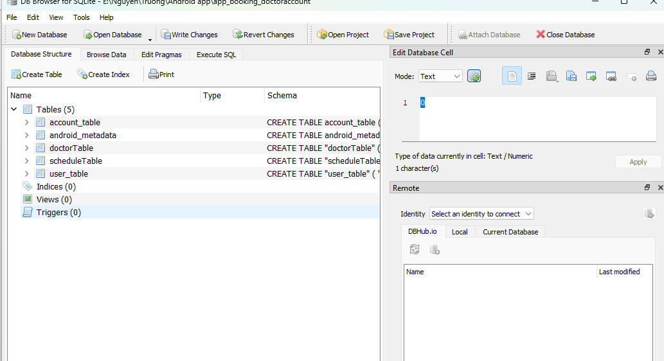
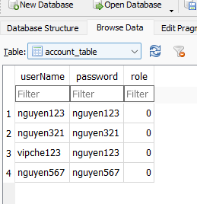
Sign-in Part 3
The SQL lite app, which contains all data value for our app
Insight the “account_table”

Slide 12
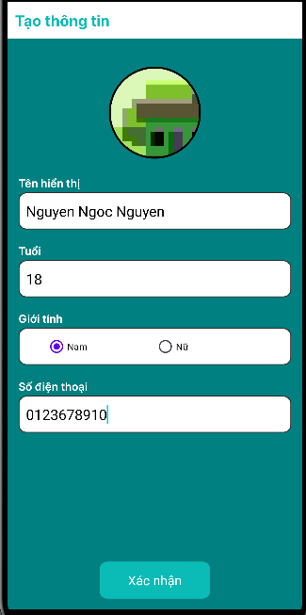
Edit_user_infor pages
These “input” component is for getting user’s information to update user’s data in table after user first sign-up process
There are buttons for user to choose sex , also at the “avatar icon”, there is also option for user to update there avatar which image from there image library
After this process, they will navigated to “Main_Home_Page”

Slide 13

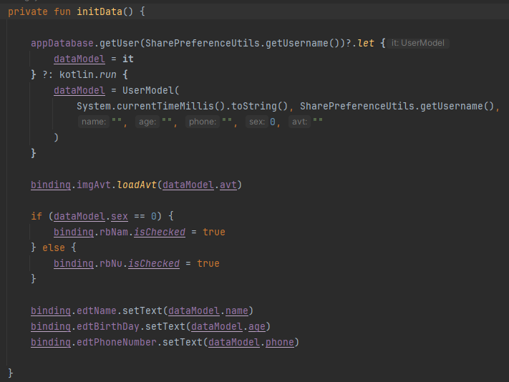
Edit_user_infor part 1
The location file of EditInfoActivity which handle all the interaction in “Edit_User_Infor” page
`initData` retrieves the user data from the database using the username stored in shared preferences.
If the user data exists, it populates dataModel with the retrieved data or If the user data does not exist, it initializes dataModel with default values.
It then sets the user's avatar, sex, name, birth date, and phone number in the corresponding views.

Slide 14
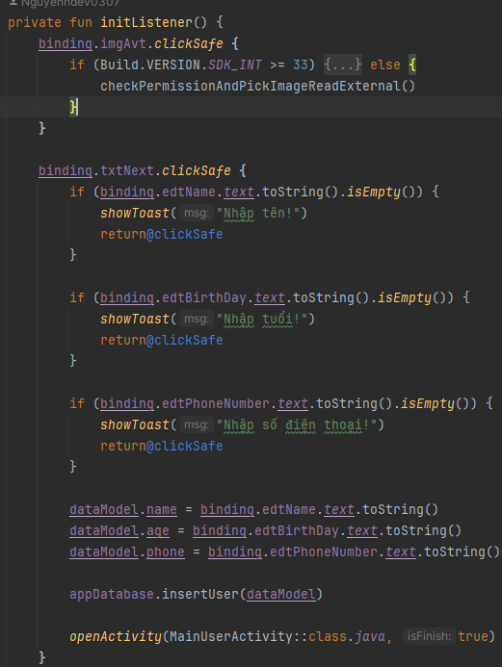
Edit_user_infor part 2
The function for asking “User” to allow App used “phone camera or library” for chose avartar
Check missing input of user. IF there is, there will an alert to warn user
Get “Input value” and update user’s infor with “insertUser(dataModel)” the parameter is a Class type data which is “userModel”

Slide 15

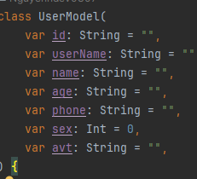
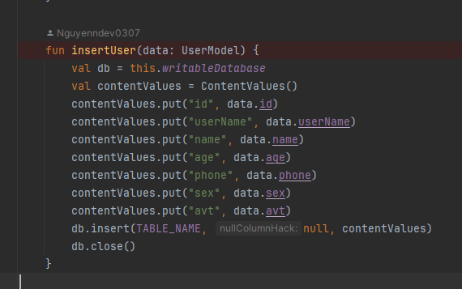
Edit_user_infor part 3
dataModel in this file is base on the User Model
InsertUser(data:UserModel) function for update User’s information

Slide 16
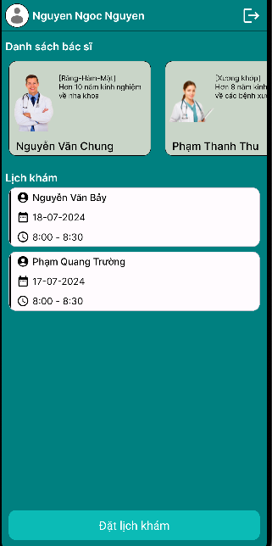
Main_Home_page
This “main_home_page” show the list of doctor and also the all user’s appointment schedule
This slider “list of doctor” when we click on that card, It navigates us to “Booking_page” which auto filled the appointment schedule for us
When we click on card of docter’s appointment. It will toggle show the detail of appointment’s schedule
This button will navigate user to “Booking_page”

Slide 17

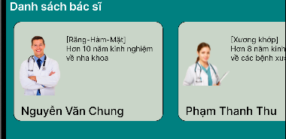
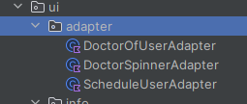
Main_Home_page Part 1
The “Main_Home_Page” file location, This page will show all the value data of user . From list of all doctor, to list of all user’s schedule
The “Main_Home_Page” file location, The page does not much logical process, however it’s handle with “view_component”. Means we setup how the component should be show. Like the list of data
DoctorOfUserAdapter
To handle this process, I create an folder (adapter) inside UI folder which contains all “custom-component”.

Slide 18
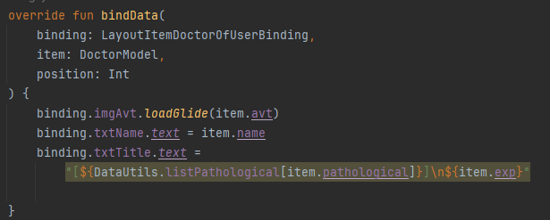
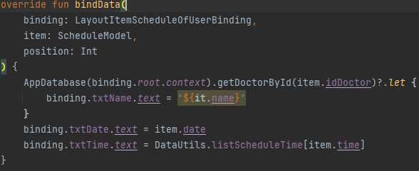

Main_Home_page Part 2
DoctorOfUserAdapter
The “DocterOfUserAdapter”included the “Image”, “Name”, and “Doctor’s pathological
The “ScheduleUserAdapter” included the “Docter name”, “Data time”, and “Doct”

Slide 19
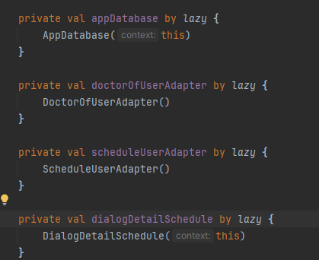

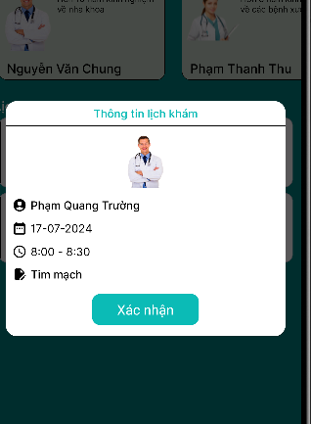
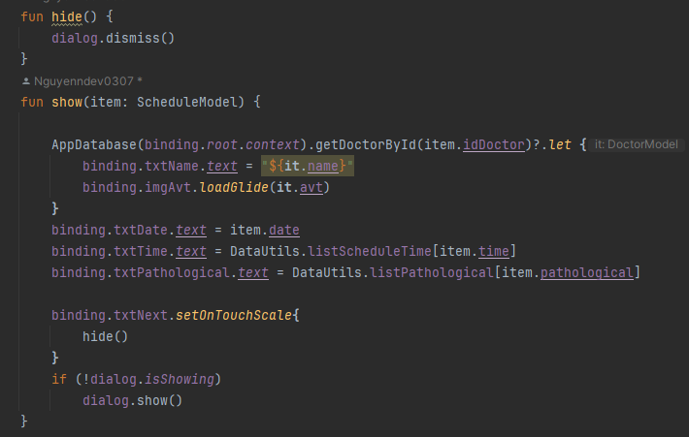
Main_Home_page Part 2
For having animation effect of our app, we used “Dialog” this file is library from “Android studio”
Hide and Show function code for “schedule component” in “Main_Home_Part”

Slide 20
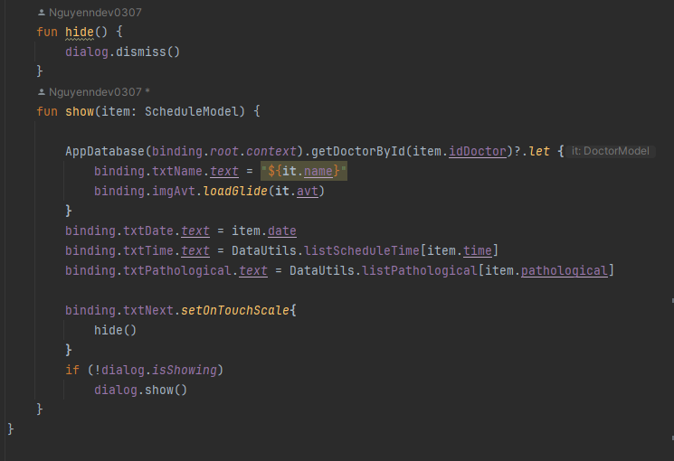
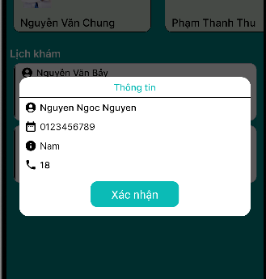
Main_Home_page Part 2
Hide and Show function code for “User_component” in “Main_Home_Part”

Slide 21
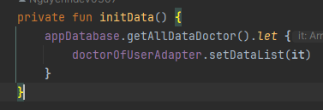
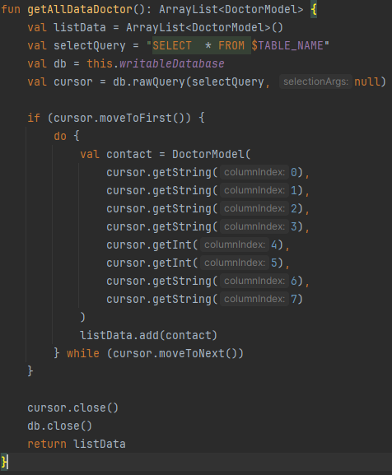
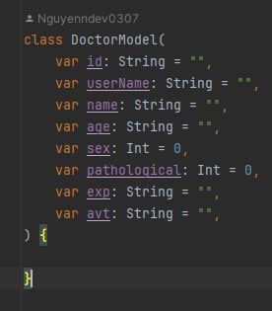
Main_Home_page Part 3
To get all list of doctor the n pass this list into doctore_adapter component
This function will search the database in SQLlite, then return an list of “Doctor_Model” for
Class of “DoctoreModel”

Slide 22
Main_Home_page Part 3
To get all list of doctor then pass this list into doctore_adapter component
This function will search the database in SQLlite, then return an list of “Doctor_Model” for
Class of “DoctoreModel”

Slide 23
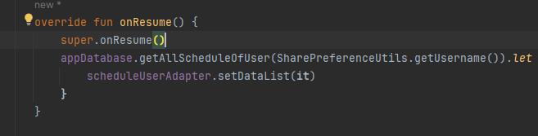
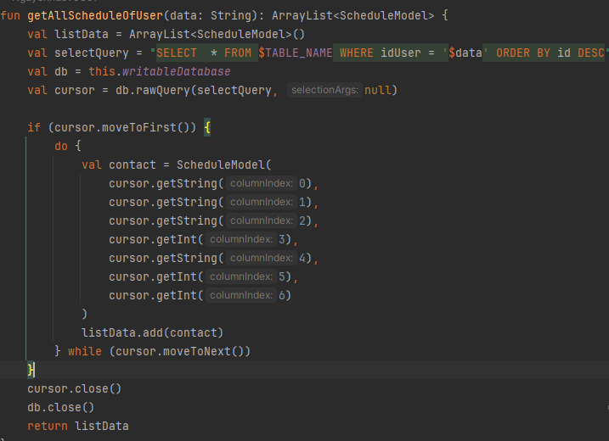
Main_Home_page Part 3
To get all list of schedule then pass this list into doctore_adapter component
We use “onResum()” function instead “initData()” function
“onResume” is a lifecycle method in Android. This function is like “useEffect()” on Reatjs Framework library for Web development. It will update the component if that component update data.
When user creates a new booking the schedule_Adapter will auto update
This function will search the database in SQLlite, then return an list of “Doctor_Model” for

Slide 24
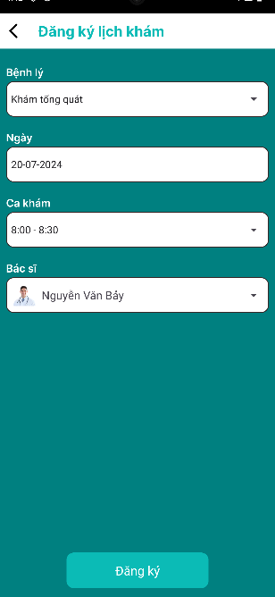
Booking Feature
The booking features will take all input of “Patient” to create new schedule for user
For user to Sign-Up requires:
Pathological (means types of treatment)
Date
Time
Docter (Docter will be showed based on their Pathological that used chose)
After user click on button, the Appointment will created and storage into SQL lite store. User will be navigated to “Main_home_page” and the scheduleAdatper component will be updated by onResum()

Slide 25
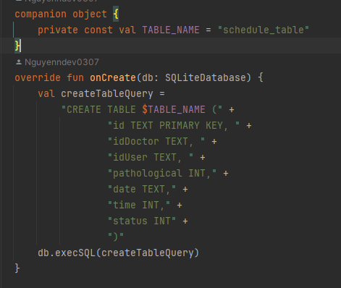
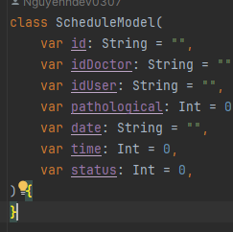
Booking Feature part 1
The setup for SQL table schedule_table. The primary key is “id”
The Class model for Schedule

Slide 26
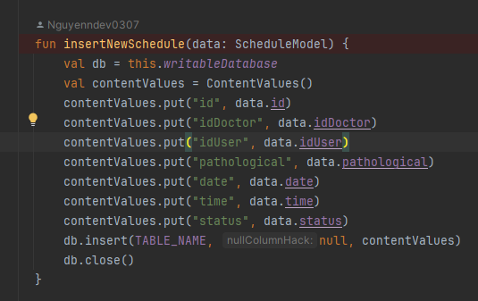
Booking Feature Part 1
Function for creating a new schedule with the data input of user and store to SQLlite

Slide 27
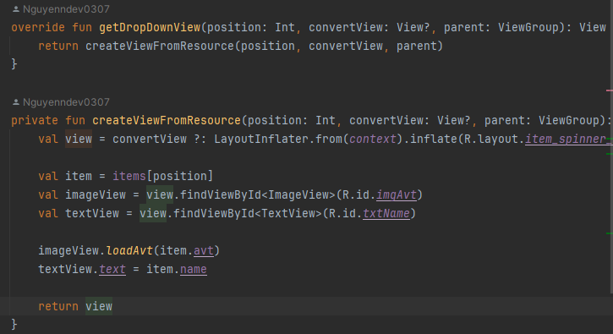
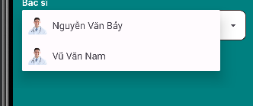
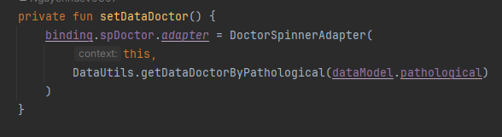
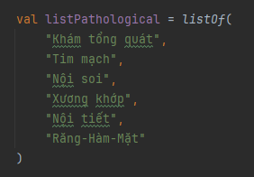
For dropDown list doctor, we also create a adapter for that with name “DocterSpinnerAdapter”
This function will generate “Doctors” with the same “pathological” that user chose
The list of Pathological

Slide 28

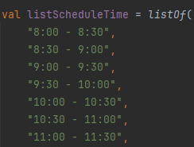
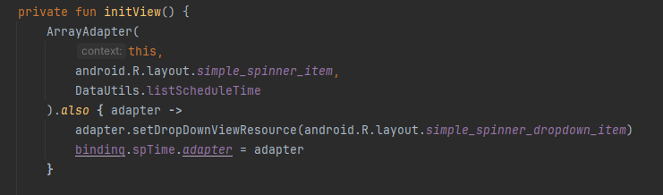
Booking Feature Part 1
The data for “time” input of Schedule, we created a list of time data, the time will begin from 8h to 19h
The code for choosing the time for booking

Slide 29

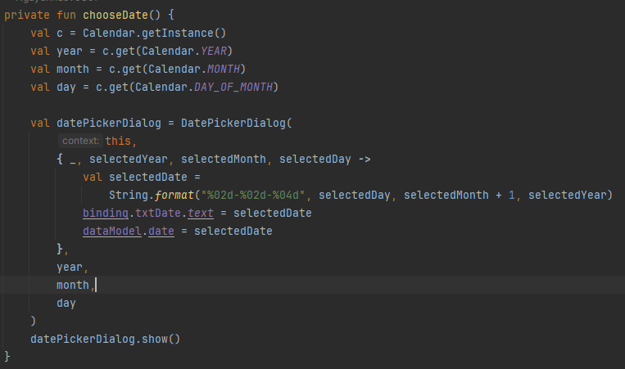
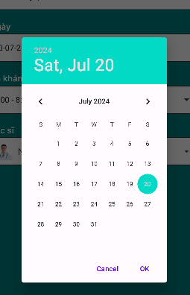
Booking Feature Part 1
The “Date” input type, We created base on Android Studio library
The code for choosing the Date for booking

Slide 30
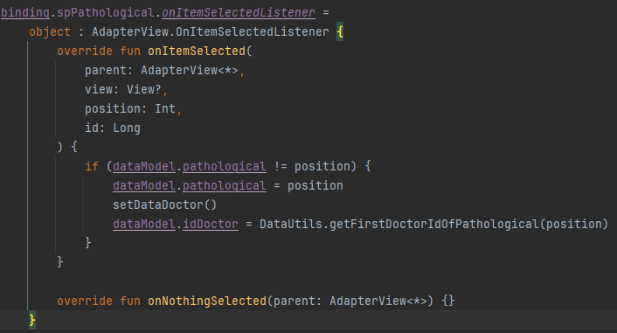

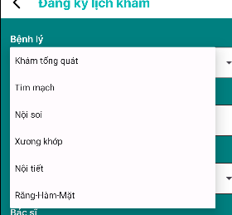
Booking Feature Part 1
As here, we used the “Adapter library” for the basic format of input. After get the “Pathological” input, Also an function to get the ‘input” doctor who is the first one with patological data attriubtes
The pathological for “Patient” to chose

Slide 31

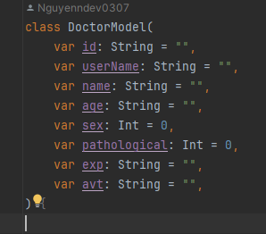
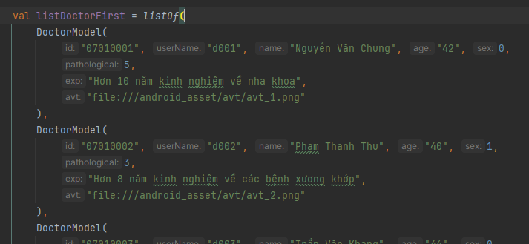
Doctor MoDel and function
Because there is no “admin function” for our app, for the doctor data we choose to integrate into our code. But these data is still storage in SQL lite storage.
For handle that process, we firstcreate “DataUtils.kt” file inside utlils folder.
The class of DataModel
List of our Doctor, for creating a new Doctor. We insert into this file

Slide 32
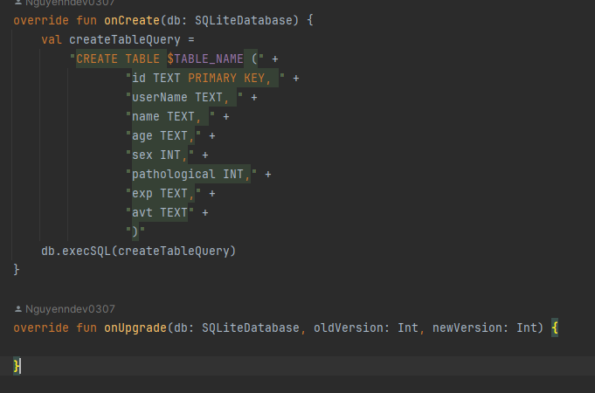
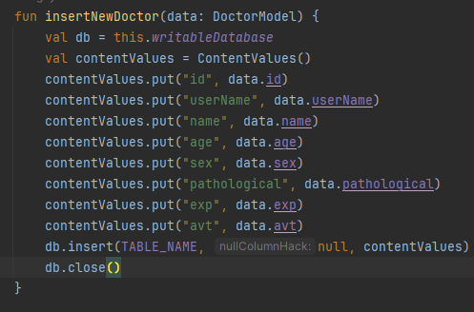
Doctor MoDel and function
To intergrate “Doctor_list” into SQL lite, we first setup data_table for doctor list
Function to inserting new Doctor into SQL lite

Slide 33



Doctor MoDel and function
To use “insertAllList”Doctor function into our SQl lite, we hide this function run inside “splasash” page
This function is only becomes valuable to the first time user. These data will auto stored in SQL lite.
For the admin function app, we will try to create in our future work

Slide 34
Thank you
For your reding

